Slide 1
Mining Association Rules ——Constraint-based Association Mining——
徐华
清华大学 计算机系 智能技术与系统国家重点实验室
xuhua@tsinghua.edu.cn

Slide 2
Association and Correlations
Association and Correlations
Efficient and Scalable Frequent Itemset Mining Methods
Mining Various Kinds of Association Rules
From Association Mining to Correlation Analysis
Constraint-based Association Mining

Slide 3
Constraint-based Mining
Finding all the patterns in a database autonomously? — unrealistic!
The patterns could be too many but not focused!
Data mining should be an interactive process
User directs what to be mined using a data mining query language (or a graphical user interface)
Constraint-based mining
User flexibility: provides constraints on what to be mined
System optimization: explores such constraints for efficient mining—constraint-based mining

Slide 4
Constraints in Data Mining
Knowledge type constraint
classification, association, etc.
Data constraint — using SQL-like queries
find product pairs sold together in stores in Chicago in Dec.’02
Dimension/level constraint
in relevance to region, price, brand, customer category
Rule (or pattern) constraint
small sales (price < $10) triggers big sales (sum > $200)
Interestingness constraint
strong rules: min_support ≥ 3%, min_confidence ≥ 60%
Constraint based mining makes mining effective and efficient

Slide 5
Metarule-Guided Mining of Asso. Rule
Specify the syntactic form of rules they are interested in mining.
Metarule can be used as constraints to help improve the efficiency of the mining process.
Metarules are based on the analyst’s experiment, expectations, or intuition regarding the data.
metarule
P1(X, W) ∧ P2(X, V) ⇒ buys(X, “educational software”)
matched rule:
age(X, “30..39”) ∧ income(x, “42..48K”)
⇒ buys (X, “educational software”)
predicate variable and attribute variable

Slide 6
Metarule-Guided Mining of Asso. Rule
A rule template (inter-dimention association rule )：
P_{i,} and Q_{i:} instantiated predicates, predicate variables,
p＝l＋r: the number of predicates in metarule，
Find all the frequent p-predicate sets, Lp
Have the support or count of the l-predicate subsets of Lp in order to compute the confidence of rules derived from Lp
Data cube: p-D cuboid and l-D cuboid

Slide 7
Constraint pushing: Mining Guided by Additional Rule Constrains
Hybrid-dimensional association rule mining
Constant initiation and aggregate functions
One example
Find the sales of what cheap items that may promote the sales of what expensive items in the same category for Chicago customers in 2004
Sales (customer-name, item-name, TID)
lives-in (customer-name, region, city)
Item (item-name, group, price)
Transaction (TID, day, month, year)

Slide 8
Constraint pushing: Mining Guided by Additional Rule Constrains
(1) mine associations as
(2) lives in(C; ; “Chicago") ^ sales+(C; ?{I}; {S}) ) sales+(C; ?{J}; {T}) (metarule)
(3) from sales
(4) where S.year = 2004 and T.year = 2004 and I.group = J.group
(5) group by C, I.group (dimension level constraints)
(6) having sum(I.price) < 100 and min(J.price) >=500
(constraint pushing? Rule constraints)
(7) with support threshold = 1% (interestingness constraints)
(8) with confidence threshold = 50%
lives in(C; ; “Chicago") ^ sales(C; “Census_CD"; )^
sales(C; “MS=Office"; )=>sales(C; “MS=SQLServer"; ); [1:5%; 68%]

Slide 9
Constraint pushing: Mining Guided by Additional Rule Constrains
How can we use rule constraints to prune the search space?
what kind of rule constraints can be ‘pushed' deep into the mining process and still ensure the completeness of the answer returned for a mining query?
Categories of rule constraint
Anti-monotonic (反单调的)
Monotonic (单调的)
Succinct (简洁的)
Convertible (可转变的)
Inconvertible (不可转变的)

Slide 10
Anti-Monotonicity in Constraint Pushing
Anti-monotonicity
When an itemset S violates the constraint, so does any of its superset
sum(S.Price) ≤ v is anti-monotone
sum(S.Price) ≥ v is not anti-monotone
Example. C: range(S.profit) ≤ 15 is anti-monotone
Itemset ab violates C
So does every superset of ab
Item | Profit
a | 40
b | 0
c | -20
d | 10
e | -30
f | 30
g | 20
h | -10
TID | Transaction
10 | a, b, c, d, f
20 | b, c, d, f, g, h
30 | a, c, d, e, f
40 | c, e, f, g
TDB (min_sup=2)

Slide 11
Monotonicity for Constraint Pushing
Monotonicity
When an itemset S satisfies the constraint, so does any of its superset
sum(S.Price) ≥ v is monotone
min(S.Price) ≤ v is monotone
Example. C: range(S.profit) ≥ 15
Itemset ab satisfies C
So does every superset of ab
Item | Profit
a | 40
b | 0
c | -20
d | 10
e | -30
f | 30
g | 20
h | -10
TID | Transaction
10 | a, b, c, d, f
20 | b, c, d, f, g, h
30 | a, c, d, e, f
40 | c, e, f, g
TDB (min_sup=2)

Slide 12
Succinctness
Succinctness:
Given A_{1,} the set of items satisfying a succinctness constraint C, then any set S satisfying C is based on A₁ , i.e., S contains a subset belonging to A₁
Idea: Without looking at the transaction database, whether an itemset S satisfies constraint C can be determined based on the selection of items
min(S.Price) ≤ v is succinct
sum(S.Price) ≥ v is not succinct
Optimization: If C is succinct, C is pre-counting pushable.

Slide 13
The Apriori Algorithm — Example
Supmin=2
Database D
L₁
C₁
Scan D
C₂
C₂
L₂
Scan D
C₃
Scan D
L₃

Slide 14
Naïve Algorithm: Apriori + Constraint
Supmin=2
Database D
L₁
C₁
Scan D
C₂
C₂
L₂
Scan D
C₃
Scan D
L₃
Constraint:
Sum{S.price} < 5

Slide 15
The Constrained Apriori Algorithm: Push an Anti-monotone Constraint Deep
Supmin=2
Database D
L₁
C₁
Scan D
C₂
C₂
L₂
Scan D
C₃
Scan D
L₃
Constraint:
Sum{S.price} < 5

Slide 16
The Constrained Apriori Algorithm: Push a Succinct Constraint Deep
Supmin=2
Database D
L₁
C₁
Scan D
C₂
C₂
L₂
Scan D
not immediately
to be used
C₃
Scan D
L₃
Constraint:
min{S.price } <= 1

Slide 17
Converting “Tough” Constraints
Convert tough constraints into anti-monotone or monotone by properly ordering items
Examine C: avg(S.profit) ≥ 25
Order items in value-descending order
<a, f, g, d, b, h, c, e>
If an itemset afb violates C
So does afbh, afb*
It becomes anti-monotone!
Item | Profit
a | 40
b | 0
c | -20
d | 10
e | -30
f | 30
g | 20
h | -10
TID | Transaction
10 | a, b, c, d, f
20 | b, c, d, f, g, h
30 | a, c, d, e, f
40 | c, e, f, g
TDB (min_sup=2)

Slide 18
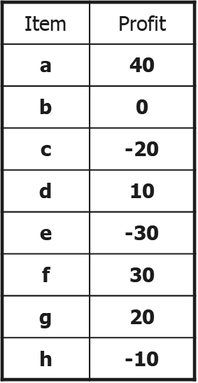
Strongly Convertible Constraints
avg(X) ≥ 25 is convertible anti-monotone
w.r.t. item value descending order R: <a, f,
g, d, b, h, c, e>
If an itemset af violates a constraint C, so
does every itemset with af as prefix, such
as afd
avg(X) ≥ 25 is convertible monotone w.r.t.
item value ascending order R⁻¹: <e, c, h, b,
d, g, f, a>
If an itemset d satisfies a constraint C, so
does itemsets df and dfa, which having d as
a prefix
Thus, avg(X) ≥ 25 is strongly convertible

Slide 19
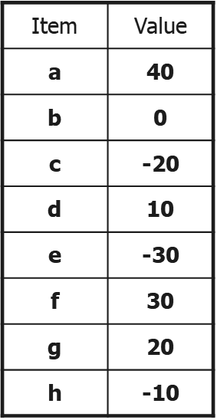
Can Apriori Handle Convertible Constraint?
A convertible, not monotone nor anti-monotone
nor succinct constraint cannot be pushed deep
into an Apriori mining algorithm
Within the level wise framework, no direct
pruning based on the constraint can be made
Itemset df violates constraint C: avg(X)>=25
Since adf satisfies C, Apriori needs df to assemble
adf, df cannot be pruned
But it can be pushed into frequent-pattern growth
framework!

Slide 20
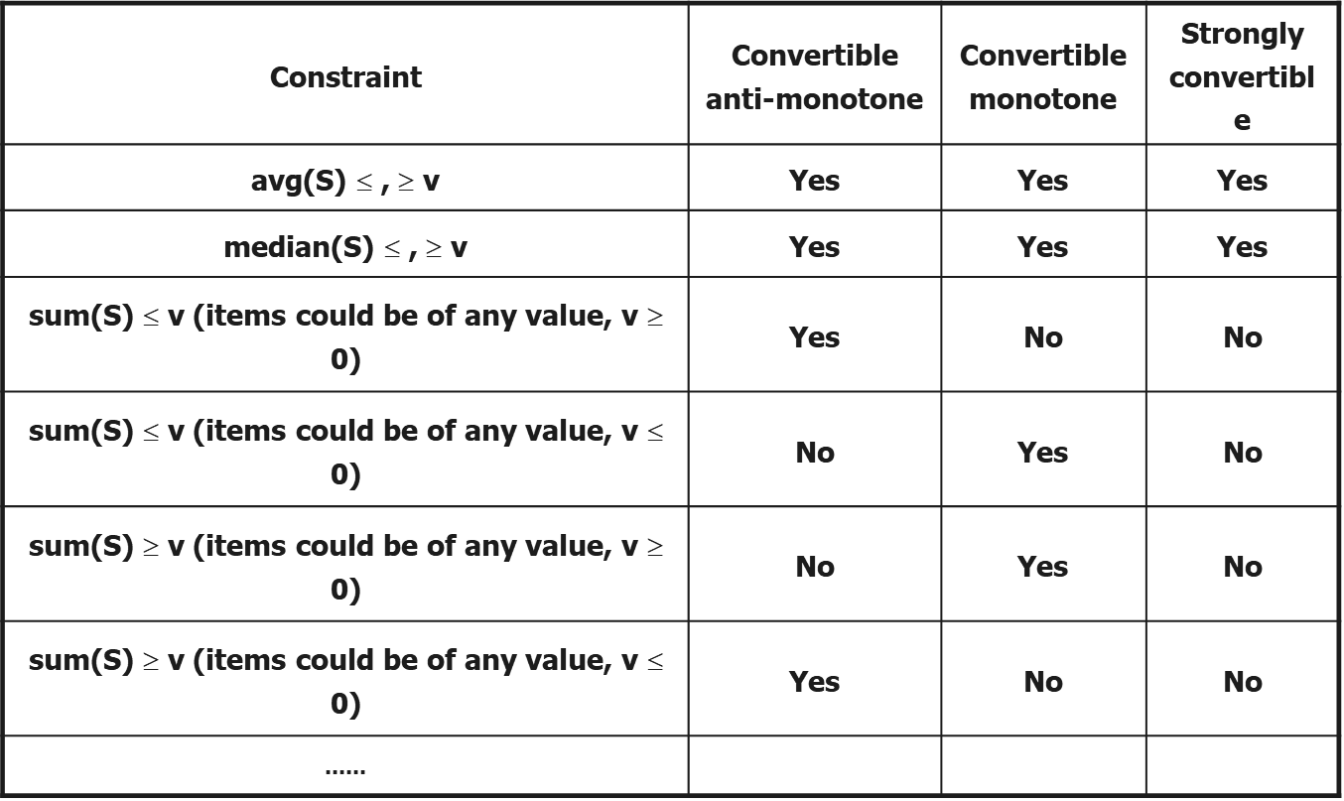
What Constraints Are Convertible?

Slide 21
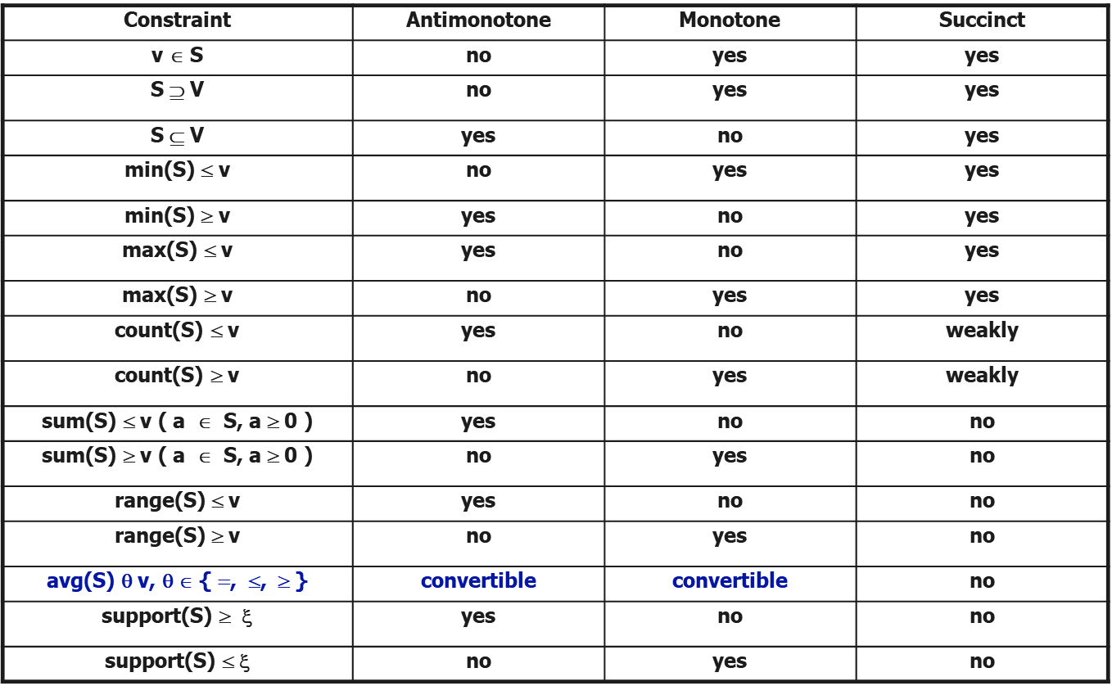
Constraint-Based Mining—A General Picture

Slide 22
A Classification of Constraints
Monotone
Antimonotone
Strongly
convertible
Succinct
Convertible
anti-monotone
Convertible
monotone
Inconvertible

Slide 23
Summary
Concept of Association rule mining
Association rule categories
Apriori association rule mining
FP-tree growth association rule mining
Mining various kinds of association rules
Constraint based association rule mining

Slide 24
Thanks！
Notes:
工作新意图发现

